Slide 1
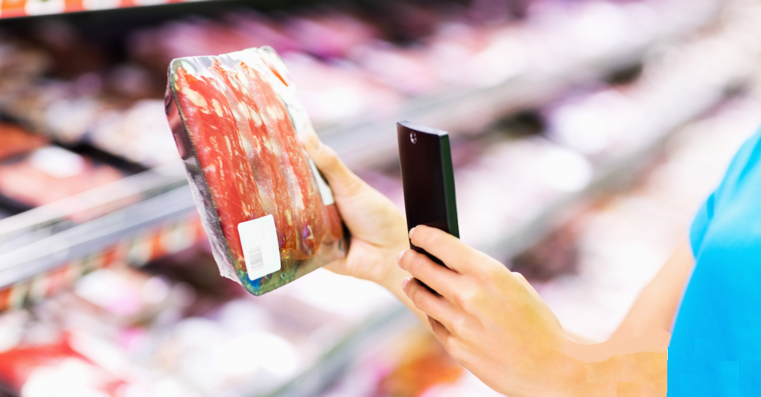
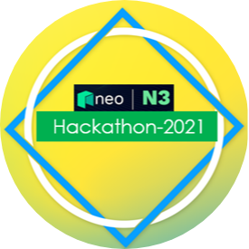
Food product traceability & transparency system Powered by Neo Blockchain, IoT, AI and cloud technologies
Food product traceability & transparency system Powered by Neo Blockchain, IoT, AI and cloud technologies
Food Lover Squad - India
Team- Food Lover Squad

Slide 2



Team – Food Lover Squad
Piyush Jain
Sr. Engineering Lead
Exp: 16 years
Tech skills: C#, .Net, Cloud, Blockchain, AI/ML, Python
Industry: Insurance , Airlines, Food industry supply chain
Brijesh Kumar
Sr. Experience Lead
Exp: 10 years
Tech skills: ReactJS, NodeJS, Azure, UI/UX, Python, Blockchain
Industry: Insurance , Education, Food industry supply chain
Chirag Khanna
Sr. Technology Lead
Exp: 7 years
Tech skills: .Net, Python, Cloud, AI/ML, Blockchain
Industry: Insurance , Hospitality

Slide 3
Use case: Food product industry concerns – Quality, Safety and loosing consumer’s trust due to lack of traceability and transparency in current system
1
2
Consumer Concerns
Food Industry Concerns
Lack of data for food product procurement, processing and Quality check parameters of the product that they are eating.
Consumer must relay on the company unstructured data to trust on the product quality.
Not able to find complete trace history of the product.
What are the quality checks done at various stages in supply chain.
Due to lots of different systems involve in Food processing and supply chain, it is difficult to maintain all records on single platform.
Due to lack of data and transparency for food product companies are losing trust to their consumers.
Difficult to stand in competitive market where every other company is trying to mobilize the consumers.
Food Product safety Quality Concerns
3
Government Agencies Concerns to Ensure Quality
Difficult to find specialists and various tools to inspect different kind of food products and get them certified time to time.
Difficult to prove that specific Food product is 100% safe to eat or not?
Notes:
This template was inserted from Power-user, the productivity add-in for PowerPoint, Excel and Word.
Get thousands of templates, icons, maps, diagrams and charts with Power-user. Visit www.powerusersoftwares.com!

Slide 4
Blockchain and IoT devices-based system in Food Product Industry to improve traceability and transparency
Globally Blockchain market is expected to grow at a CAGR of 67.3% from 2020 to reach $39.7 billion by 2025.
Source:-Article
As per the official data, about 35% manufacturing industries adopt blockchain technology for Food safety and traceability by 2022.

Slide 5



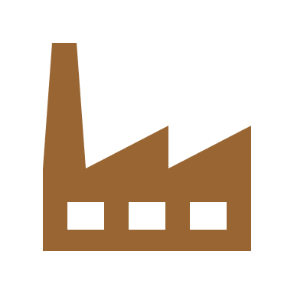
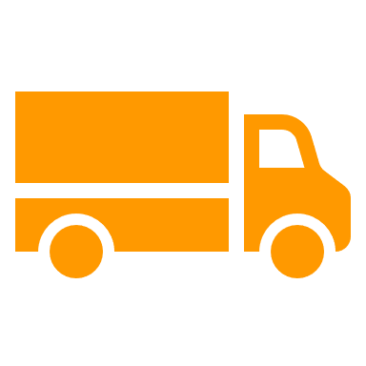
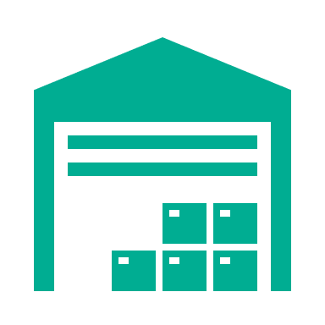

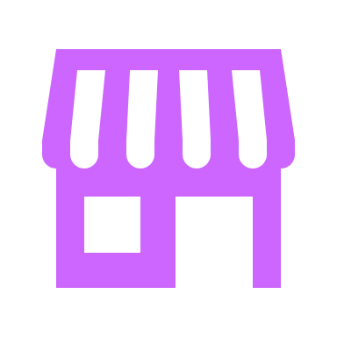
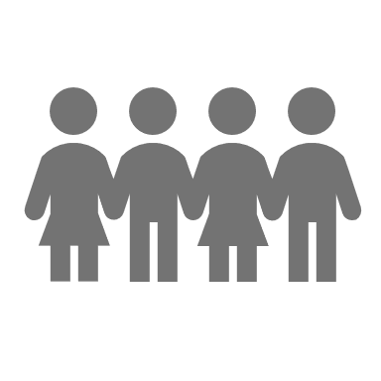
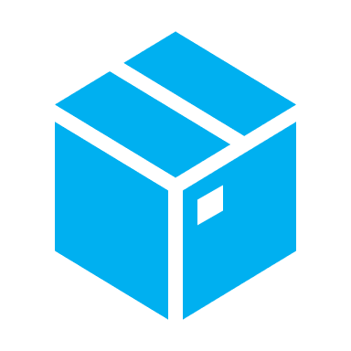

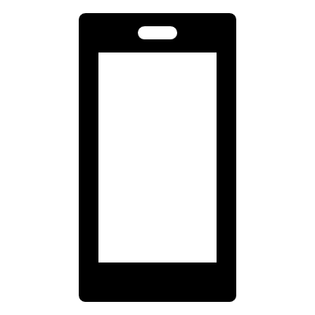

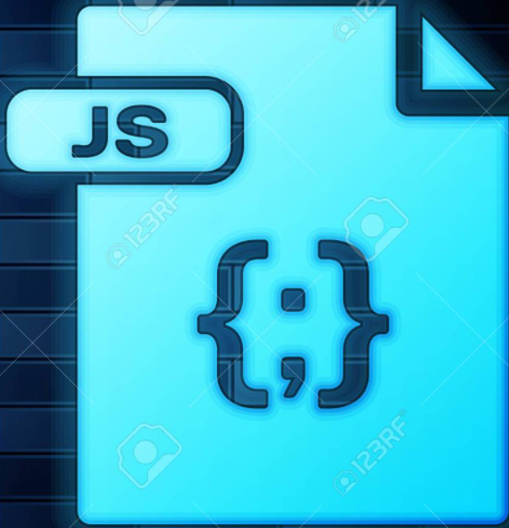
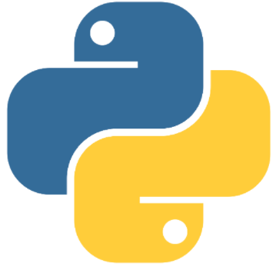


High Level Architecture Flow Diagram
Food product- Ice-Cream traceability & transparency with blockchain
Food Product (Ice-cream) Processing and Distribution
App
App
App
IoT
App
IoT
Raw material sources
Manufacturing unit
Shipping Unit
Transportation
Warehouse
Transportation
Retail Shop
Consumers
Stage 2
IoT Devices
Stage 1
Stage 3
Different
Quality
Checkpoint
Create a block for Raw Material Resources
IoT Data
Create a block for Shipping Unit
Create a block for packet received information in retail store
Create a block for transportation
Create a block for warehouse entry
Create a block for transportation
Neo N3 Blockchain
Dapp
Neo N3
Python
Neo boa
Neon.js
Native Contracts (Python)
Block 1
Certification of origin
Block 2
Batch Number
Block 3
Batch Number
Block 4
Batch Number
Quality Checks
Block 5
Warehouse Id
Block 6
Batch Number
Block 7
Retail store ID
Quality Checks
Dry-fruits
Milk powder
Sugar
Flavorings
Approved additives
Mixing Quality
Thickness
Packing
Temperature
Quality Checks
Temperature
Shipment Date
Manufacturing Date
Expiry Date
Shipment No
Temperature
Retail Transport ID
Warehouse Receive Date
Quality Checks
Temperature
Quality Checks
Temperature
Retail Invoice Number
Retail Receive Date
Quality Checks
Temperature
Batch number
Batch number
Batch Number
Read Only
Read Only
Read Only
Read Only
Read Only
Read Only
Read Only
Frontend App (Read-only data)
React.js
Neon.js
Application to Read product histories data at any stage of decentralized Blockchain system using Batch Number
Key Features:
Provide complete transparency of Food product processing from raw material procurement to final delivery to end consumer.
Defining the Quality ownership and accountability of various stack holders of the product at every stage.
Provide complete traceability of product.
In blockchain based distributed eco system each participants can have separate app to interact and create a new block.
In case of Quality check failure measured by any IoT devices, further blocks cannot be created.
Consumers

Slide 6
Live Demo
Team- Food Lover Squad

Slide 7
Benefits of the MVP Product
Transparent information sharing with consumer at different stages of Food Processing.
Inspection efficiency with this low effort solution. This will help government agencies to inspect and issue Food certificates in faster way.
Accurate and informed decisions can be taken related to Food Product safety and Quality.
Product History is easily traceable from procurement of raw material to final deliver to consumer hand by passes from various supply chain modules using Unique Batch number stored in blockchain system.
Food product industry will gain trust from consumer by making complete process more transparent and traceable by connecting all different vendors and tools to single platform.
Best-in-class performance and scalable solution based on Neo Blockchain framework.
In nutshell, win-win solution for both consumer and Food product industry to use this cost effective and reliable solution.

Slide 8
Thank you
Team- Food Lover Squad

